Slide 1

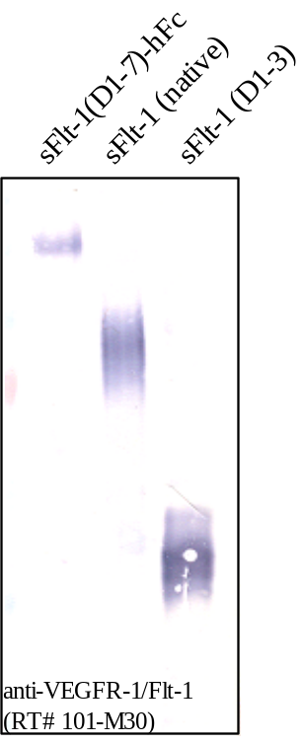
ReliaTech GmbH
Mouse anti-human VEGFR-1/Flt-1 (#EWI)
(Cat #101-M30)
Figure 1. Western analysis of recombinant human soluble Flt-1 proteins using a monoclonal anti-human VEGFR-1/Flt-1 antibody [Cat# 101-M30].
http://www.reliatech.de / orders@reliatech.de

